Slide 1


ROAD ACCIDENT ANALYSIS DASHBOARD
SUBMITTED BY :
AYSHA PARVEEN ALAM (BCS2022253)
SUBMITTED TO:
DEPARTMENT OF COMPUTER SCIENCE AND ENGINEERING

Slide 2


Slide 3
The Road Accident Dashboard: A Tool for Saving Lives

Slide 4

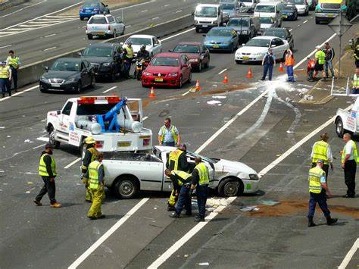
Introduction
Road accidents in India are a significant concern, with a high frequency of incidents causing injuries and fatalities. The complex road network, diverse traffic, and various factors contribute to this alarming issue.

Slide 5
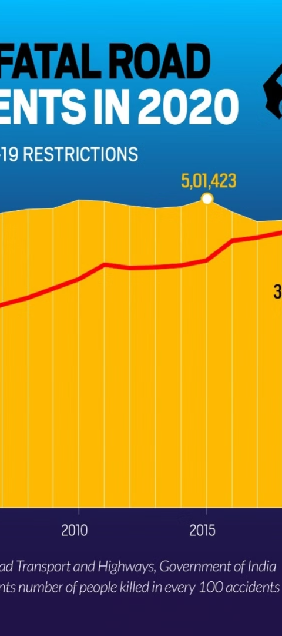
Data sources and collection methods
National Crime Records Bureau (NCRB)
State Police Departments
Contribute accident data from specific states for comprehensive analysis.
Collects data on road accidents, fatalities, and injuries nationwide.
Ministry of Road Transport and Highways (MORTH)
Primary authority responsible for road accident data collection methodologies.

Slide 6

Requirements and KPI
90%
300K
2.5M
Compliance Rate
Accidents Recorded
Vehicle Count
Percentage of adherence to road safety regulations
Total number of road accidents documented for analysis
Total vehicles contributing to the dataset
The analysis requires a 90% compliance rate of road safety regulations, with a dataset consisting of 300K documented accidents and 2.5M vehicles.

Slide 7
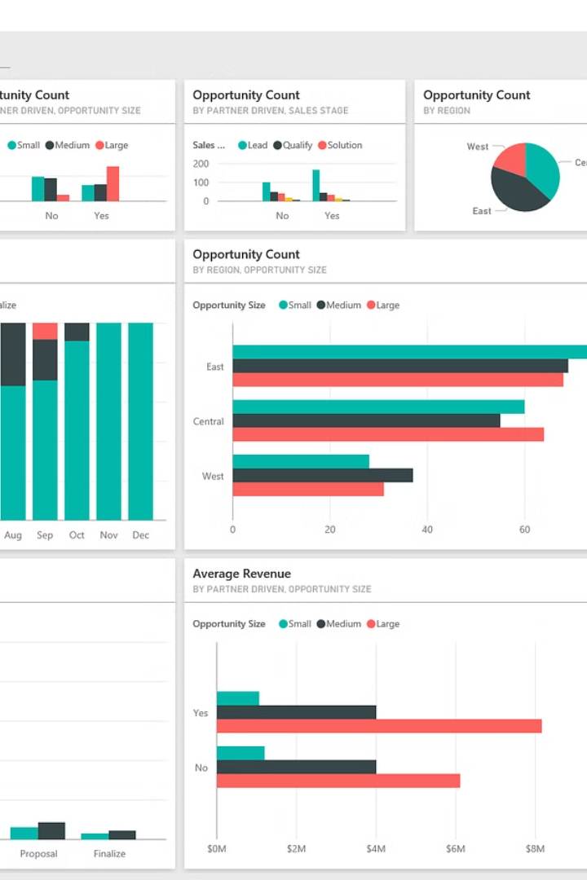
Overview of Power BI and its capabilities
Power BI is a powerful business analytics tool that enables users to visualize and share insights from data. With its user-friendly interface, it allows for seamless data integration from various sources.
Its capabilities include interactive dashboards, real-time analytics, and easy collaboration, making it a valuable asset for analyzing complex datasets.

Slide 8
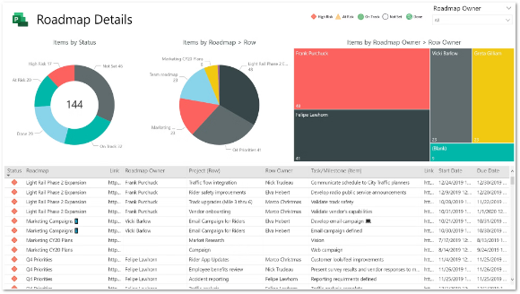
Visualizing road accident analysis data with Power BI
Visualizing road accident analysis data is crucial for extracting meaningful insights. With Power BI's robust visualization features, complex road data can be transformed into intuitive and interactive dashboards.

Slide 9
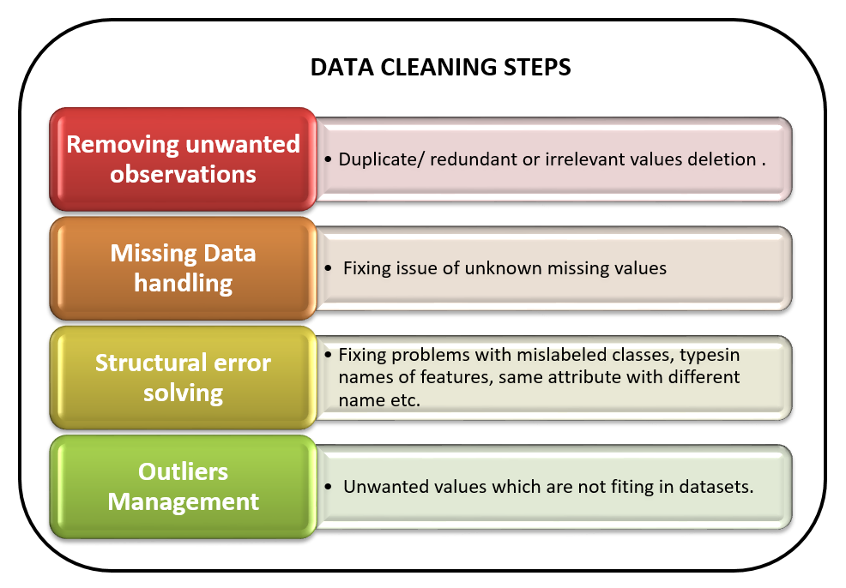
Data cleaning and preparation for analysis
Removing duplicates and inconsistencies: Utilizing scripting and data cleaning tools to ensure accurate and reliable datasets.
Handling missing values: Implementing methods such as imputation or removal to address missing data points.
Standardizing data formats: Converting data into a uniform structure to facilitate analysis and visualization.

Slide 10
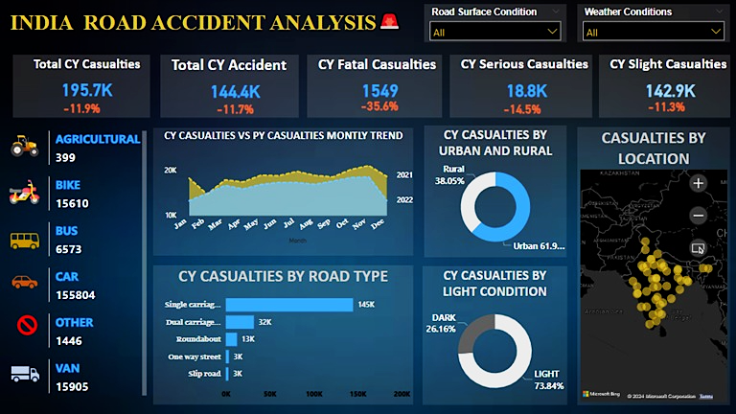
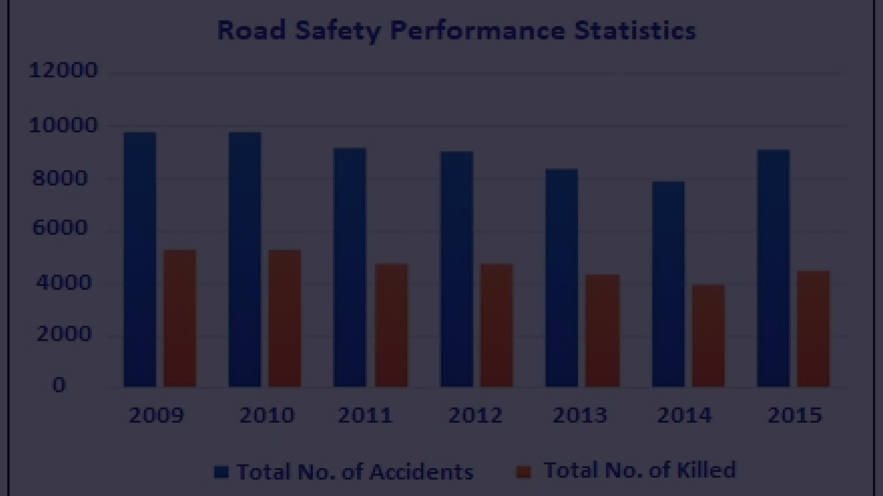
Visualizing Accident Data
Location
1
Mapping accident hotspots using location chart according to area using GPS coordinates.
2
Time
Plotting accidents on a timeline to identify peak hours or periods.
Type
3
Categorizing accidents by type such as collisions, rollovers, or pedestrian incidents.

Slide 11
Identifying High-Risk Areas and Factors
Location Analysis
Contributing Factors
Using geospatial data to pinpoint areas with the highest accident rates.
Examining data to identify common factors such as speeding and poor road conditions.
Identifying specific intersections and road segments prone to accidents.
Analyzing weather and visibility conditions at the time of accidents.

Slide 12
Analyzing the Effectiveness of Road Safety Measures
1
Impact of Traffic Signals
2
Enforcement of Speed Limits
Traffic signal compliance and its role in reducing accidents.
The correlation between enforcing speed limits and accident rates.
3
Effectiveness of Safety Barriers
4
Role of Education and Awareness Campaigns
Assessing the impact of safety barriers in preventing collisions.
Evaluating the effectiveness of campaigns in promoting road safety.

Slide 13




Recommendations for improving road safety in India
Clear Signage
Promote Safety Gear
Upgrade Traffic Signals
Educational Campaigns
Implement clear and visible road signs to indicate hazards, speed limits, and directions.
Encourage the use of helmets, seat belts, and reflective clothing for all road users.
Modernize traffic signals for better control and management of intersections and pedestrian crossings.
Launch educational initiatives to raise awareness about road safety laws and best practices.

Slide 14
Conclusion and Future Directions
After analyzing the road accident data in India, it's clear that there's a pressing need for comprehensive safety measures. The next steps involve collaborating with local authorities to implement targeted interventions, leveraging technology for real-time monitoring, and raising public awareness through educational campaigns.
This approach will require a multi-stakeholder strategy and continual evaluation to ensure sustainable improvements in road safety across the country.

Slide 15
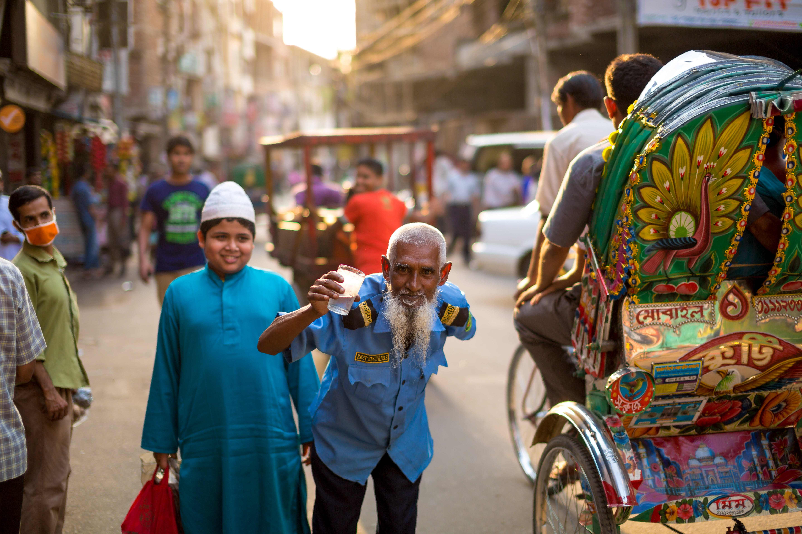
DHNAYAWAD🙏🏻
THANK YOU

